Slide 1
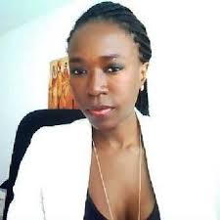
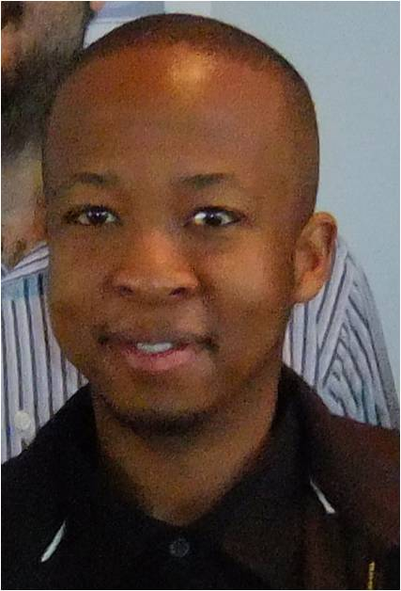
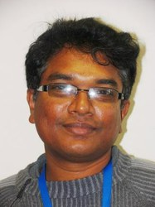
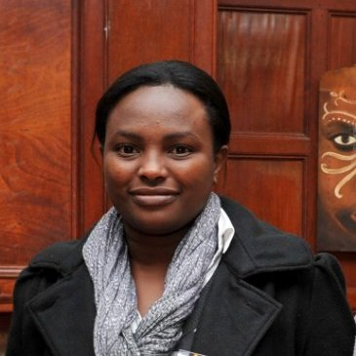
Department of Chemical Engineering
Congratulations to our PhD-graduates
Doreen Nabaho
Noko Ngoepe
Pat
Thirunavukkarasu Pathmathas
Margreth Tadie

Slide 2
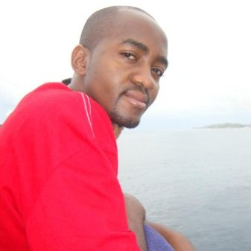
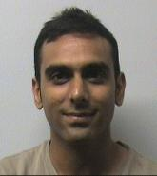
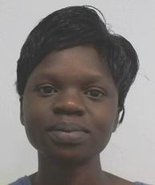
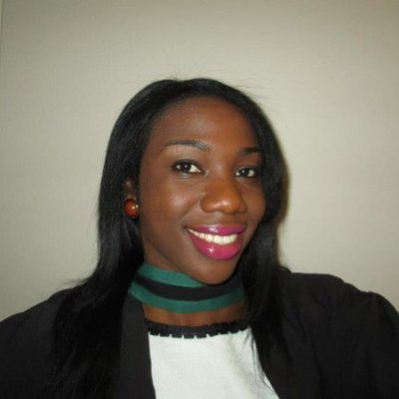
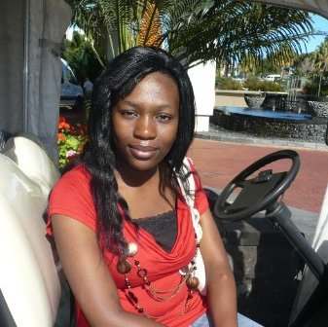
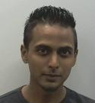
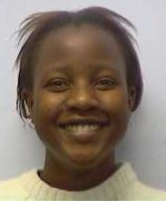
Department of Chemical Engineering
Congratulations to our MSc-graduates
Tapiwa Chivengwa
Darin Dickson
Vuyiswa Dube
Onyinye Iroala
Jo-Anne Crimes
Zethu Dlamini
Dirren Govender
Fadzai Kadzinga

Slide 3
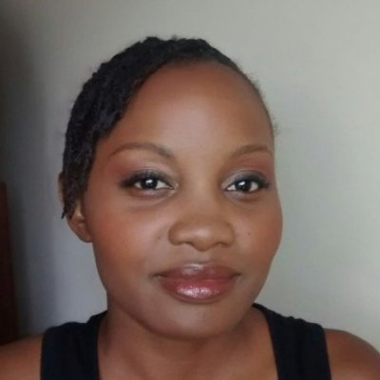
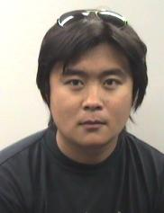
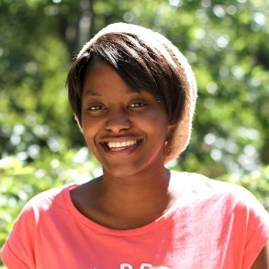
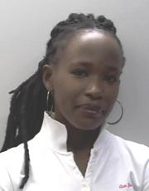
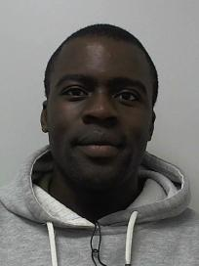
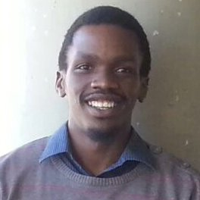
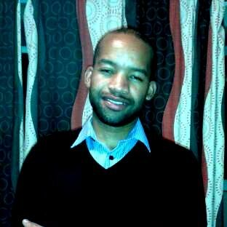
Department of Chemical Engineering
Congratulations to our MSc-graduates
Monica Kalichini
Cong Liu
Kabwe Musonda
Faustine Ngoroma
Chucky Kunene
Tafadzwa Marozva
Timothy Magezi Ndamera
Steven Nkadimeng

Slide 4
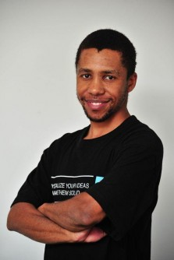
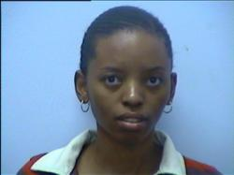
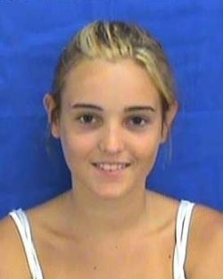
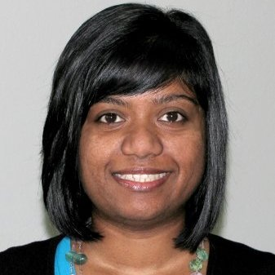
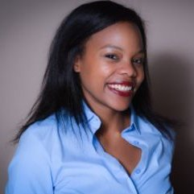
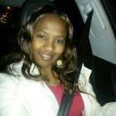
Department of Chemical Engineering
Congratulations to our MSc-graduates
Edward Peters
Mamohlomi Senoko-Mtshisa
Courtney Thompson
Keshree Pillay
Melissa Sikosana
Hundzukani Vukeya

